Slide 1

2D ARRAY , SORT & SEARCH
PRESENTED BY :
GROUP - 7
S no. | NAME | ROLL NO
1. | TANISHA CHAKRABORTY | UG/SOET/29/24/016
2. | RITIKA BERA | UG/SOET/29/24/017
3. | SHUBHADIP MONDAL | UG/SOET/29/24/019
4. | ANAL BHUNIA | UG/SOET/29/24/059

Slide 2
2D ARRAYS
The two-dimensional array can be defined as an array of arrays.
Storing Structure data

Slide 3
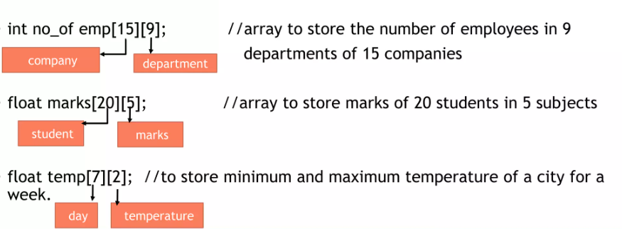
Declaring a Two-Dimensional Array
data-type name [no of rows] [no of columns];
Integral constant / literal

Slide 4
Initialization of 2D Array in C
Row-by-row initialization
We can specify all the elements row by row using curly braces {}.
int matrix[3][4] = { {1, 2, 3, 4}, // Row 1
{5, 6, 7, 8}, // Row 2
{9, 10, 11, 12} // Row 3
};
In memory, this array is stored as:
1 2 3 4
5 6 7 8
9 10 11 12
Memory Representation

Slide 5
Partial initialization
If you don’t provide all the elements, the missing ones will be initialized to 0.
int matrix[3][4] = { {1, 2}, // Remaining elements are initialized to 0
{3, 4, 5}, // One element is missing, so it will be 0
{6, 7, 8, 9} }; // Fully initialized row
This will result in:
1 2 0 0
3 4 5 0
6 7 8 9

Slide 6
Accessing Elements
A two-dimensional array element can be accessed using two indices.
Every element has two index Numbers.
Syntax:
array_name[row_index][column_index]
Array indices start at 0, so:
matrix[0][0] → First row, first column.
matrix[1][2] → Second row, third column.

Slide 7
EXAMPLE
#include <stdio.h>
int main() {
int matrix[2][3] = { {1, 2, 3}, {4, 5, 6} }; // Traversing and printing the 2D array
for(int i = 0; i < 2; i++) { // Loop for rows
for(int j = 0; j < 3; j++) { // Loop for columns
printf("matrix[%d][%d] = %d\n", i, j,matrix[i][j]);
}
}
return 0;
}
OUTPUT
matrix[0][0] = 1
matrix[0][1] = 2
matrix[0][2] = 3
matrix[1][0] = 4
matrix[1][1] = 5
matrix[1][2] = 6

Slide 8
Applications of 2D Array in C​
Matrices in Mathematics​
Image Processing​
Games like Chess, Tic-Tac-Toe
​
Graph Representation

Slide 9
What is Sort ?
Sorting is the process of arranging elements of an array in a particular order—either ascending (smallest to largest) or descending (largest to smallest).
Types
Bubble Sort | Insertion Sort | Selection sort | Quick Sort | Merge Sort | Heap Sort | Shell Sort
Tim Sort

Slide 10
Bubble Sort
Bubble Sort is a simple algorithm that organizes a list of numbers or other elements in order.
The algorithm is called bubble sort because larger elements “bubble” up to the top of the list.
EXAMPLE :
A
15 | 16 | 6 | 8 | 5
0 1 2 3 4

Slide 11
15 | 16 | 6 | 8 | 5
15 | 6 | 16 | 8 | 5
15 | 6 | 8 | 16 | 5
15 | 6 | 8 | 5 | 16
15 | 6 | 8 | 5 | 16
6 | 15 | 8 | 5 | 16
6 | 8 | 15 | 5 | 16
6 | 8 | 5 | 15 | 16
6 | 8 | 5 | 15 | 16
6 | 8 | 5 | 15 | 16
6 | 8 | 5 | 15 | 16
6 | 8 | 5 | 15 | 16
6 | 5 | 8 | 15 | 16
5 | 6 | 8 | 15 | 16
5 | 6 | 8 | 15 | 16
5 | 6 | 8 | 15 | 16
6 | 8 | 5 | 15 | 16
6 | 8 | 5 | 15 | 16
5 | 6 | 8 | 15 | 16
PASS 1
PASS 2
PASS 3
PASS 4
for i = 0
for i = 2
for i = 3
for i = 1

Slide 12
Outer Loop & Modification
for (i=0; i<n-1 ; i++){
for(j=0; j<n-1; j++){
If(A[ j ] > A[ j + 1]{
temp = A [ j ] ;
A [ j ] = A [ j + 1 ];
A [ j + 1] = temp;
}
}
}
for (i=0; i<n-1 ; i++){
for(j=0 ; ; j++){
If(A[ j ] > A[ j + 1]{
temp = A [ j ] ;
A [ j ] = A [ j + 1 ];
A [ j + 1] = temp;
}
}
}
j<n-1-2
If We do this modifications then the unnecessary modifications will be avoided

Slide 13
What is Search?
In computer science searching play a Vital role.
It is an operation or process or technique to find out desired element or A place of an element in list.
Basically, search are two types – 1) linear search & 2) binary search

Slide 14
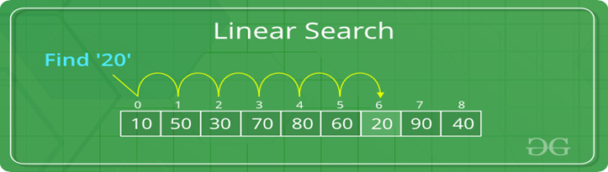
What is Linear search?
Linear search also called sequential search.
It is a simplest method of searching
This search compare every element with desire element of list, until it found.
Linear search can be performed on sorted array or unsorted array both

Slide 15
EXAMPLE:
int main(){
int n, i, key, found = 0, arr[6]={10, 5, 8,20,40,9};
printf(“Enter element to search: “);
scanf(“%d”, &key);
for(i = 0; i < 6; i++){
if(arr[i]==key);
printf(“Element %d found at index %d\n”, key,i);
found = 1;
break; }
if (found == 0){
printf(“Element %d not found in the array. \n”, key); }
return 0;
}

Slide 16
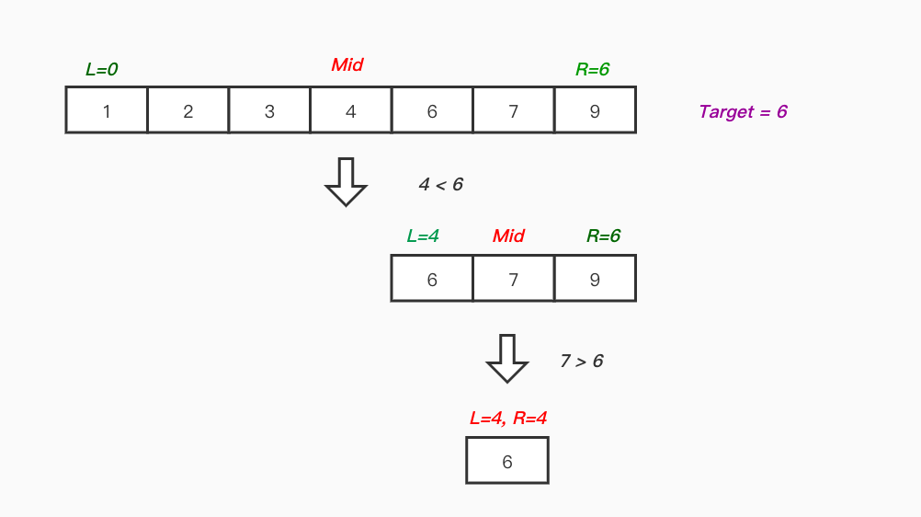
What is Binary search?
This searching technique looks for particular element by comparing the middle most element of the list.
It is a fast & efficient technique, which is useful for long list element array.
works on the principle of divided into two parts rule - repeatedly dividing the search space in half, comparing the target value with the middle element, and then focusing on the relevant half until the target is found or the search space is empty
0 1 2 3 4 5 6
4 5 6

Slide 17
EXAMPLE:
int main(){
int first, last, mid, i, sElement, list[10] = {10, 14, 22, 35, 58, 63, 70, 86, 91, 100};
printf(“Enter Element for search: ”);
scanf(“%d”, &sElement);
first = 0; last = 10 – 1; mid = (first + last)/2;
0 1 2 3 4 5 6 7 8 9
10 | 14 | 22 | 35 | 58 | 63 | 70 | 86 | 91 | 100

Slide 18
0 1 2 3 4 5 6 7 8 9
10 | 14 | 22 | 35 | 58 | 63 | 70 | 86 | 91 | 100
Middle Element
(mid)
while(first<=last){
if(list[mid] == sElement)
printf(“Element found at index %d.\n”, mid);
break; }
else if (list[mid] < sElement){
first = mid +1; }
else{
last = mid -1; }
mid = (first + last)/2; }
if (first>last){
printf(“Element Not Found in the list.”); }
}
return 0;
Output
Enter Element for search: 63
Element found at index 5.

Slide 19
References
YouTube :
https://youtu.be/o4bAoo_gFBU?si=bm7MBJ4He- 049JY_
https://youtu.be/C46QfTjVCNU?si=7TEL2NBz75CjFE9i
https://www.youtube.com/watch?v=V_T5NuccwRA&t=1s
Stack overflow:
https://stackoverflow.com/questions/35137500/2d-array-initialization-of-columns-vs-rows

Slide 20
Conclusion
2D arrays are essential for storing structured data.
Arranging the element in the order from smallest to largest elements
Linear search is simple but less efficient for large data sets, whereas binary search is faster but requires sorted data.

Slide 21
THANK YOU

